Slide 1

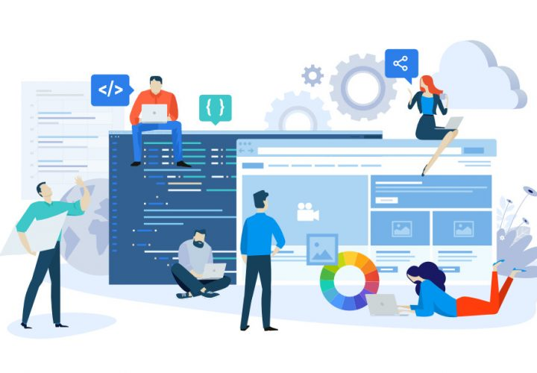

National University of Computer and Emerging Sciences
Software Design and Architecture
Hira Naveed
Lecture # 5 Three-tier Architecture

Slide 2
3-tier Architecture
A software architecture that organizes applications into three logical and physical computing tiers:
Presentation tier, or user interface;
Application tier, where data is processed;
Data tier, where the data associated with the application is stored and managed.

Slide 3
Tier vs Layer
Tier: physical separation
Layer: logical separation
They aren't the same.
A 'layer' refers to a functional division of the software, but a 'tier' refers to a functional division of the software that runs on separate hardware
The Contacts app on your phone, for example, is a three-layer application, but a single-tier application, because all three layers run on your phone.
The difference is important, because layers can't offer the same benefits as tiers.

Slide 4
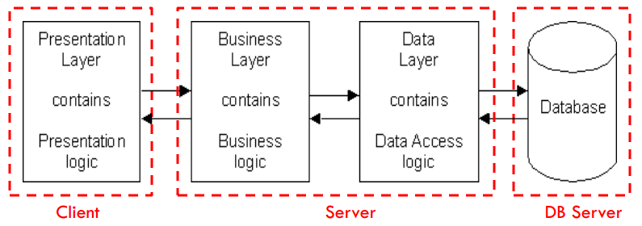
3-Tier Architecture
Each layer runs on a different machine
Presentation, logic, data layers disconnected

Slide 5
Presentation Tier
The user interface and communication layer of the application, where the end user interacts with the application.
Its main purpose is to display information to and collect information from the user.
This top-level tier can run on a web browser, as desktop application, or a graphical user interface (GUI), for example.

Slide 6
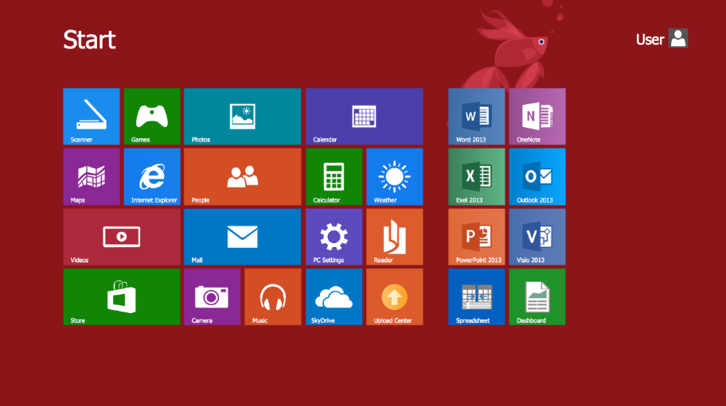
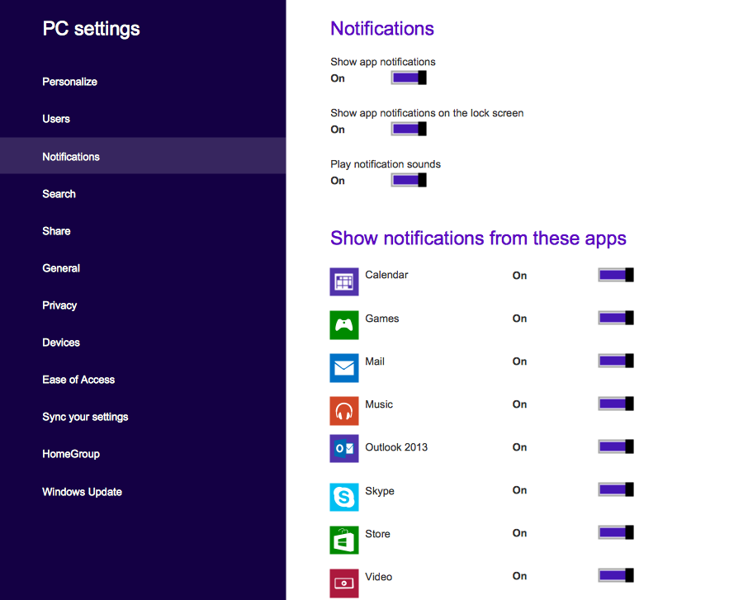
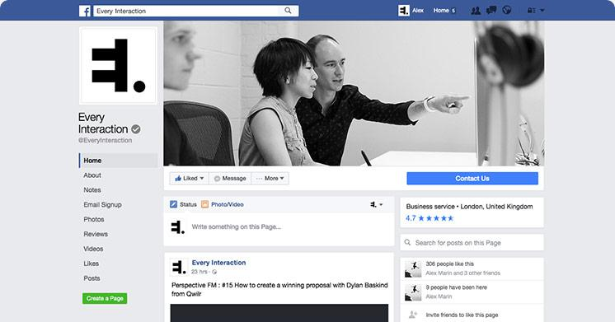
Presentation Tier

Slide 7
Application Tier
a.k.a the business logic tier, is the heart of the application
In this tier, information collected in the presentation tier is processed - using business logic, a specific set of business rules.
The application tier can also add, delete or modify data in the data tier.
The application tier is typically developed using Python, Java, Perl, PHP or Ruby, and communicates with the data tier using API calls.

Slide 8
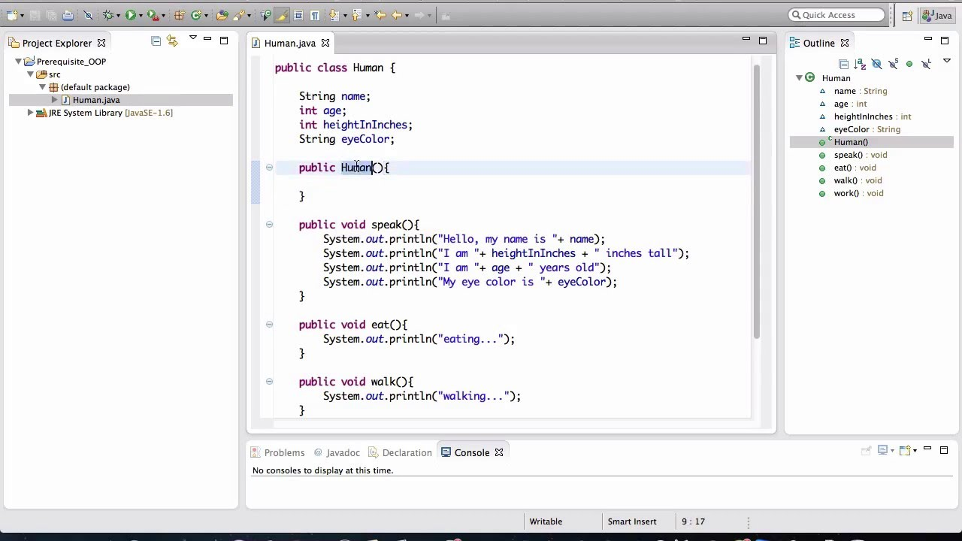
Application Tier

Slide 9
Data Tier
Also called database tier, is where the information processed by the application is stored and managed.
This can be a relational database management system such as MySQL, Oracle or a NO-SQL database like MongoDB, Hadoop etc.

Slide 10
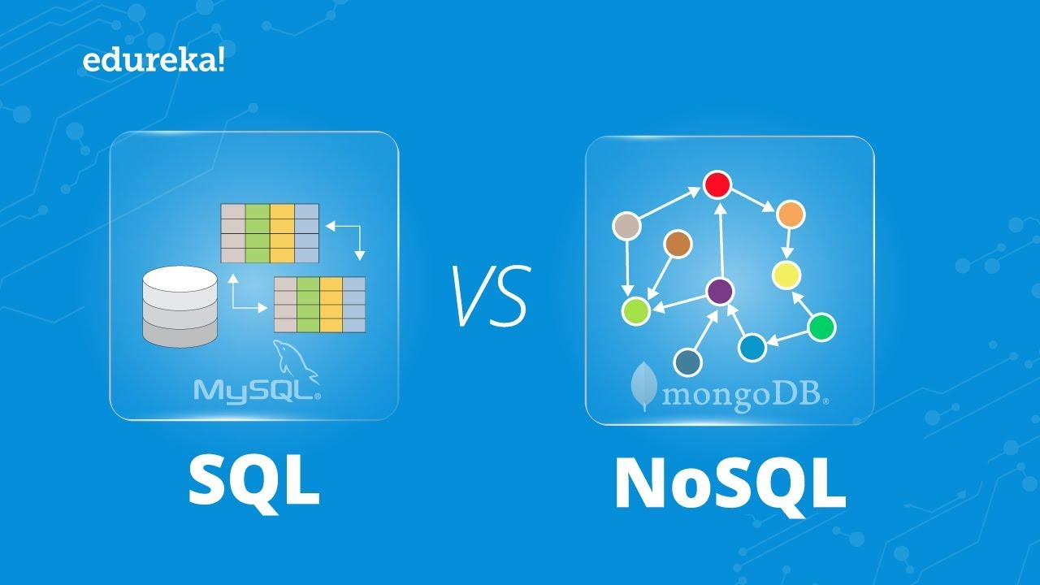
Data Tier

Slide 11
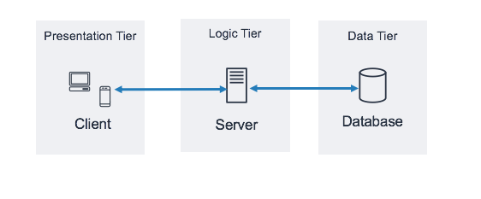
Three-Tier Architecture
In a three-tier application, all communication goes through the application tier
The presentation tier and the data tier cannot communicate directly with one another

Slide 12
N-tier Architecture
While three-tier architecture is easily the most widely-adopted multi-tier application architecture, there are others also
N-tier architecture - refers to any application architecture with more than one tier
Two-tier architecture is the original client-server architecture, consisting of a presentation tier and a data tier; the business logic lives in either the presentation tier or the data tier

Slide 13
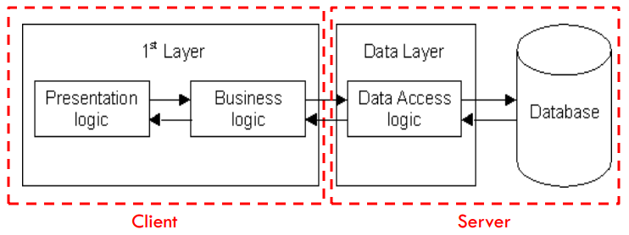
2-Tier Architecture
Database runs on Server
Separated from client
Easy to switch to a different database
Presentation and logic layers still tightly connected (coupled)
Heavy load on server
Potential congestion on network
Presentation still tied to business logic

Slide 14
Benefits of Three-Tier Architecture
Logical and physical separation of functionality
Each tier can run on a separate operating system and server platform - e.g., web server, application server, database server - that best fits its functional requirements.
Each tier runs on at least one dedicated server hardware, so the services of each tier can be customized and optimized without impact the other tiers

Slide 15
Benefits of Three-Tier Architecture
Faster development: Because each tier can be developed simultaneously by different teams, an organization can bring the application to market faster, and programmers can use the latest and best languages and tools for each tier.
Improved scalability: Any tier can be scaled independently of the others as needed.
Improved reliability: An outage in one tier is less likely to impact the availability or performance of the other tiers.
Improved security: Because the presentation tier and data tier can't communicate directly, a well-designed application tier can function as a sort of internal firewall, preventing SQL injections and other malicious exploits.

Slide 16
Example of 3-Tier Architecture
(web-based applications)
Browser
client
Web
server
Browser sends
URL to web server,
requesting a file or
program
Fetches file or runs
server side (php) script
Apache web server
SQL programming interface:
SQL commands sent
- results returned
PHP
script
1
Server returns results
file and/or program outputs
2
HTML5
phpMyAdmin
provides separate
browser-based
GUI interface
CSS
HTML: Browser displays (renders)
resulting page
PHP
MySQL
Database
SQL
MySQL
JavaScript: executed by browser
jQuery AJAX: ‘direct’ asynchronous web server connection
Javascript
HTTP (developer tools)
AJAX, jQuery notation
JSON, web services
Notes:
Refer for example to:
http://en.wikipedia.org/wiki/Multitier_architecture [last accessed 8/31/2011]
We generally consider the browser/client as one of the tiers.
Sometimes the web server box above is thought of as two of the layers [with a web server and scripts the server runs].
See such as http://www.webhostinglogic.com/support/support-topics/web-database-3tier.html

Slide 17
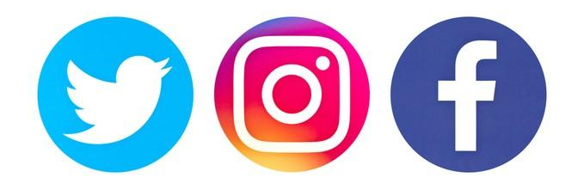
Facebook also uses Three-tier Architecture
The presentation tier of the Facebook is made up of the Web servers that create the Web pages that users see
The middle tier consists of all the business logic and data requests
The data tier consists of a database server application. This tier stores all the data about every object in the database, such as a person, photo, or event.
Notes:
Refer for example to:
http://en.wikipedia.org/wiki/Multitier_architecture [last accessed 8/31/2011]
We generally consider the browser/client as one of the tiers.
Sometimes the web server box above is thought of as two of the layers [with a web server and scripts the server runs].
See such as http://www.webhostinglogic.com/support/support-topics/web-database-3tier.html

Slide 18
3-Tier Architecture Demo
Notes:
Refer for example to:
http://en.wikipedia.org/wiki/Multitier_architecture [last accessed 8/31/2011]
We generally consider the browser/client as one of the tiers.
Sometimes the web server box above is thought of as two of the layers [with a web server and scripts the server runs].
See such as http://www.webhostinglogic.com/support/support-topics/web-database-3tier.html

